Slide 1
Prerequisites: Information on Polices and Procedures
2016

Slide 2
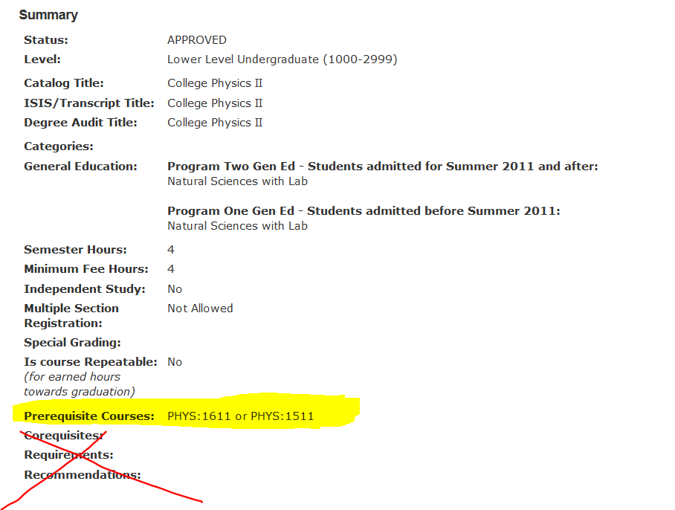
WHAT IS A PREREQUISITE?
Only items in the prerequisite field of a course officially count as prerequisites and are used to block a student's enrollment. Prerequisites may include courses or combinations of courses. If no minimum grade is seen in the course prerequisite field, then a student must pass the prerequisite course with the minimum grade of a D-. Some prerequisites have a higher standard for completion, such as the C- grade. The ALEKS or MPT 3 math placement score and world language placement scores may also be used as prerequisites if included in the prerequisite field. Corequisites and requirements are not used to block a student's registration. Restrictions (such as honors, non-major, major, senior standing, etc.) are not prerequisites and are not checked by this system.

Slide 3
KEY INFORMATION TO NOTE
Generally, all prerequisites are enforced for all CLAS undergraduate students. Prerequisites are NOT enforced for CLAS graduate students. Additionally, undergraduates in their first semester of enrollment at Iowa who register during an Orientation event are handled using special procedures. These students are given conditional permission to enroll regardless of prerequisites but must submit proof of meeting the prerequisite or will be removed.
Summer Session 4 Week or the Summer 6 Week 1 Session also has its own rules. Students do need the prerequisite completed or in progress to register. However, courses in these sessions start before spring grades are posted and this timing does not allow the removal of students who failed to receive the needed grade in a prerequisite course. Departments offering courses with prerequisites in these two summer sessions must remove students by hand.
Transfer students registering in the five business days before the semester begins are also have different procedures. They are not allowed to enroll conditionally but must present proof that the prerequisite is met at the time they register (or they may submit this proof by email asap). Conditional status is not allowed during this period because of the related timeframe (more info below.)

Slide 4
HOW DOES THE PREREQUISITE CHECKING SYSTEM WORK?
When checking for students’ completion of prerequisites, the computer application reads the UI degree audit, looking for the satisfactorily completed prerequisites or their “official equivalents.”
If a student has successfully completed the prerequisite with the required grade (i.e., the grade on MyUI in the course’s prerequisite field or a D-) by the time of registration and if that grade appears on the degree audit (not just on the grade report or transcript), the system allows the student to enroll in the related course. The student is never in this case removed automatically by the system.
The application also searches for courses “in progress.” An “in progress” course has an IP beside it on the degree audit or grade record; “IP” is both used to signify UI courses or courses a student is currently enrolled in at another institution (if the student has reported this to UI Admissions).
Students completing an “IP” prerequisite at the time of registration are allowed to “conditionally” (i.e. temporarily) enroll in the next course in the sequence until grades are posted. This permission is known officially as “Conditional-Proof Required.” We refer to it simply as “conditional.” In other words, a student is enrolled only temporarily until proof of a final grade is received.
A student earning a satisfactory grade is moved to “Met” status by the computer system and this student is never automatically removed from the course.
If a student does not earn the required final grade in the “IP” course, the student is removed permanently from the course by the system just after UI grades are officially posted. The student is not able to add the course or join the waitlist.

Slide 5
Use of the Workflow Form
Students blocked from adding a course during registration may ask for permission to enroll in the related course for many reasons. These students normally request permission to enroll using the related online form and workflow. The form is available before, during, and after registration but is removed five business days before the semester begins since there is generally not enough time to process these late requests. Students always should submit proof as soon as possible. Remind students that the form “disappears” five days before the semester begins.

Slide 6
It is easy for a student to see if they have met the prerequisite. First, a student who is looking at the course schedule is reminded to log in to MyUI to find out if that prerequisite has been met by the student. This also reminds students, even when just browsing for courses, that prerequisites are important.

Slide 7
Once a student logs in to MyUI through the student’s account, the system can "see" if the student has the prerequisite met for a course and alerts the student to this fact. Below, the student is told the prerequisite is met.

Slide 8
Here the student is logged in and the student is told the prerequisite is NOT met. A link is given to the student for a form that allows the student to explain the circumstances of why there is no “readable” proof on the degree audit that the student has met the prerequisite. For example, a student might have completed a higher-level course than the stated prerequisite, yet the computer program can’t “read” this special situation. Hence the student must contact the someone for help. The best way to do so is for the student to use the form at the link below which is sent directly to that “someone” via workflow.
The name of the form has changed to Prerequisite Permission to Enroll Form

Slide 9
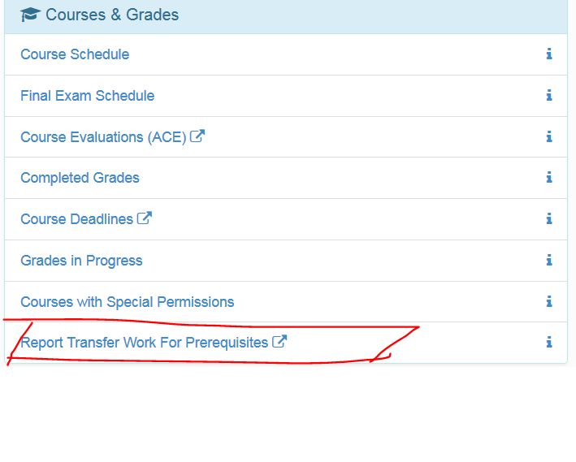
A student may also find this form at the student's personal MyUI account by logging in and going to Student Information tab. The prerequisite form is listed under "Courses and Grades.“ NOTE: The form has been renamed as “Prerequisite Permission to Enroll Form” and allows students to submit those “unreadable” reasons by which they have fulfilled a prerequisite. The form is removed five business days before the semester begins; at this point, students must ask for permanent permission in a different way so they know their schedule before the semester begins. Conditional permission and the use of the form are no longer allowed.
Note the name for the form is the Prerequisite Permission to Enroll Form.

Slide 10
IMPORTANT DEADLINES
Five-business days before the semester begins, students will no longer have access to the workflow form to request conditional permission or to submit proof that a prerequisite is met via workflow. The form will close after midnight on that 5th business day before the start of the semester in question—so very early in the morning. Students expecting to submit proof of a prerequisite being met may need your help. Forms in progress in workflow are processed but no new forms may be sent.
Five-business days before the semester begins, “conditional permission proof required” will no longer be a choice for the type of permission given.
Three business days before the semester begins students in conditional status are removed from the related course.
Students with “In Progress IP” course work from UI will be removed the day after grades are posted from the previous semester or sessions if the student has not passed the course or earned the needed grade. For Fall 2016, the grade load from Summer begins on Thursday, August 11 and takes one to two days to complete. Students will be removed as soon as that process is completed—either Saturday or Sunday.

Slide 11
LIMITATIONS OF THE SYSTEM
The prerequisites are enforced at all times in CLAS if the prerequisites appear in the course prerequisite field on MyUI or in the MAUI course library. CLAS does not make exceptions to the required prerequisites.
However, the prerequisite system is unable to read many forms of completed course work or life experiences that fulfill a prerequisite but which are not programmable.
These include the following:
Taking a higher level course in the same area of study as the prerequisite
Taking two or three courses that cover the same material as the prerequisite but which are not officially on the degree audit as doing so
Successfully completing a course at another institution without the grade yet visible on the student’s degree audit.
Gaining knowledge of another language outside of taking a course, such as learning the language from a family member or living in that country etc.

Slide 12
Role of Advisors During the Five-Business Days before the Semester Begins
CLAS advisors will be able to help transfer students in the advisor’s caseload who are registering during the late orientation sessions scheduled during the five-business days before classes start.
During this week, continuing students in the advisor’s caseload who are removed or blocked may also be helped by a CLAS advisor.
Advisors will be able override the prerequisite enforcement system (PES) for students in their caseload. Before doing so, the advisor should have proof from the student that the prerequisite is met. This may be “unofficial” proof, such as screen shot of a grade book showing the student passed the course or related types of proof not yet be processed by UI. NOTE: Advisors will be able to override the block for any course with the administrative home in CLAS.

Slide 13
Other Procedures and Policy
CLAS advisors will not have access to allow other special permissions, such as to override section-level restrictions (such as Honors, majors only etc) unless that is part of the advisor’s regular duties as decided by the department. The advisor will likewise not be able to give course-level special permission unless part of the advisor’s current duties. NOTE: During other times in the semester, the student must continue to use the workflow system and the department’s normal procedures if a student wants permission to enroll because of a prerequisite issue. No one should override the system outside of the five-day window unless the advisor is also the workflow form recipient. This is CLAS policy.

Slide 14
How to Override PES:
For students who have never been enrolled in the related course
Find the student in MAUI.
Go to the special permission page using the pull down menu in the right-hand corner of the student’s page (Special Permission is under Registrar).
Make sure the session box on the right is set to the semester needed.
Once on the student’s special permission page, go to the bottom and add the course in the blue Prerequisite Special Permission box.
Select Met Proof Provided in Status box.
Click on the Grant prerequisite special permission button.
[Note: For those with rights to approve section or course-level special permission, additional approval panels will appear on this page. Section-level permission also automatically gives prerequisite permission. Course-level permission does not grant prerequisite permission and must be granted separately using the pull-down menu a second time.

Slide 15
How to Override PES:
For students who have been enrolled in the related course but have been removed and are in “Not Met” Status
If a student was in a course but has been removed and you thus see a Not Met in the status field next to the course information you must remove the row with the course FIRST information and student status before you are able to override PES.
Use the delete button below to remove this course row and current student status; you may then add the course to the prerequisite special permission field in the blue box; choose the Met Proof Provided status.

Slide 16
How to Override PES:
For students who are still in conditional status
Students who are still in conditional status may no longer use the workflow process to submit proof beginning five business days before the start of the semester. These same students will be removed three business days before the start of the semester if not moved to Met Proof Provided status. If the student has the prerequisite met, they may contact you for help. To override PES for these students, note the following.
Do NOT use the blue box to enter the course number and to change student status to Met Proof Provided.
Instead use the pull down menu in the course information row below, choosing Met Proof Provide (if, of course, the student has this proof for you).

Slide 17
Students earning I or O grades remain enrolled until three business days before classes begin and then are removed. Students with Incompletes or O’s will need your help.
ODDS and ENDS
A transfer course grade may appear on the student’s grade report but not yet on the degree audit since the course has not been reviewed for transfer status by Admissions. In other words, it perhaps has not yet been made equivalent to the prerequisite in question. The computer application reads the degree audit and not the grade report to ensure transfer courses are on the degree audit in an approved manner. It takes Admissions around 3-5 days to review transfer credit since they can receive 500+ requests per day, depending on the season.
A student can’t join a waitlist unless the course’s prerequisites are met or the student has been given conditional or permanent or special permission to enroll. Remember, permanent permission or conditional permission does not guarantee a student a seat and DOES NOT ENROLL the student in the course.
Please remind instructors teaching courses with prerequisites not to sign paper add forms unless the instructor has proof that the prerequisite has been met. Unfortunately, a few students try to take advantage of an instructor’s goodwill and end up failing the course since the student is not prepared to take it.

Slide 18
Reports
There are two reports you may look at on MAUI. Once in MAUI, go to the Registrar tab and choose offerings planner. The reports may be found in the left column at the bottom.
Offerings Planner > Method of Meeting Prerequisites Report
This shows how students met a prerequisite. This report is NOT live but is updated every 24 hours, generally and thus may not match other reports. As students are removed by the system, you should see fewer red or orange notes under Status—and more students in green status. This report does not show how many students were removed but only the current status of those in a course. This report shows all courses with the same acronym if desired, loading more quickly than the other report generally (!).

Slide 19
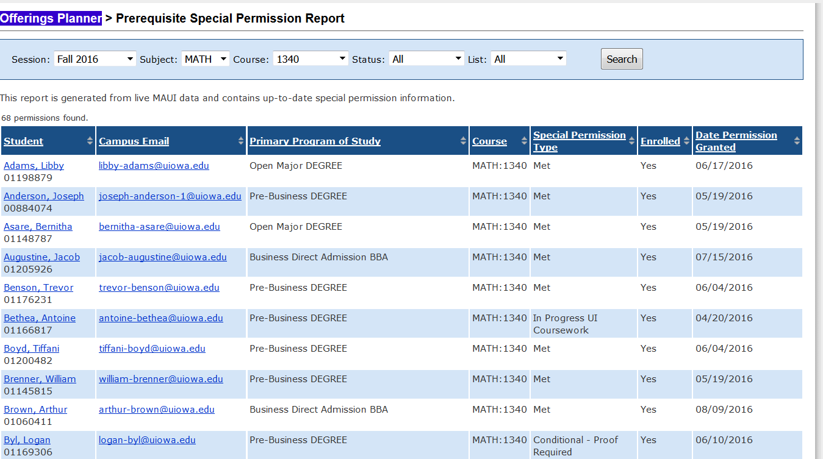
Offerings Planner > Prerequisite Special Permission Report
This report is LIVE and shows a student’s most recent status and has a link to the student record page. Since it is live do not be worried if the student’s status does not match the other report (the method of meeting prerequisite report)—the report below is the accurate one. This report can be very helpful particularly if you work with certain courses in majors continually and you want to see the number of students in conditional status who might be surprised to be removed and will need help—though not all of these students are in your caseload. The status types are Permanent, Met Proof Provided, Conditional Proof Required, and Not Met.

