Slide 1
GIS Applications in the Water Management Sector
Mary Windsor
Geographer
USACE-Rock Island, Project Management, GIS
Date: 19 September 2018

Slide 2
Objectives
Introduce USACE-Rock Island and the PM GIS section
Provide an overview of some current GIS projects
Pathways Program Student Intern position

Slide 3
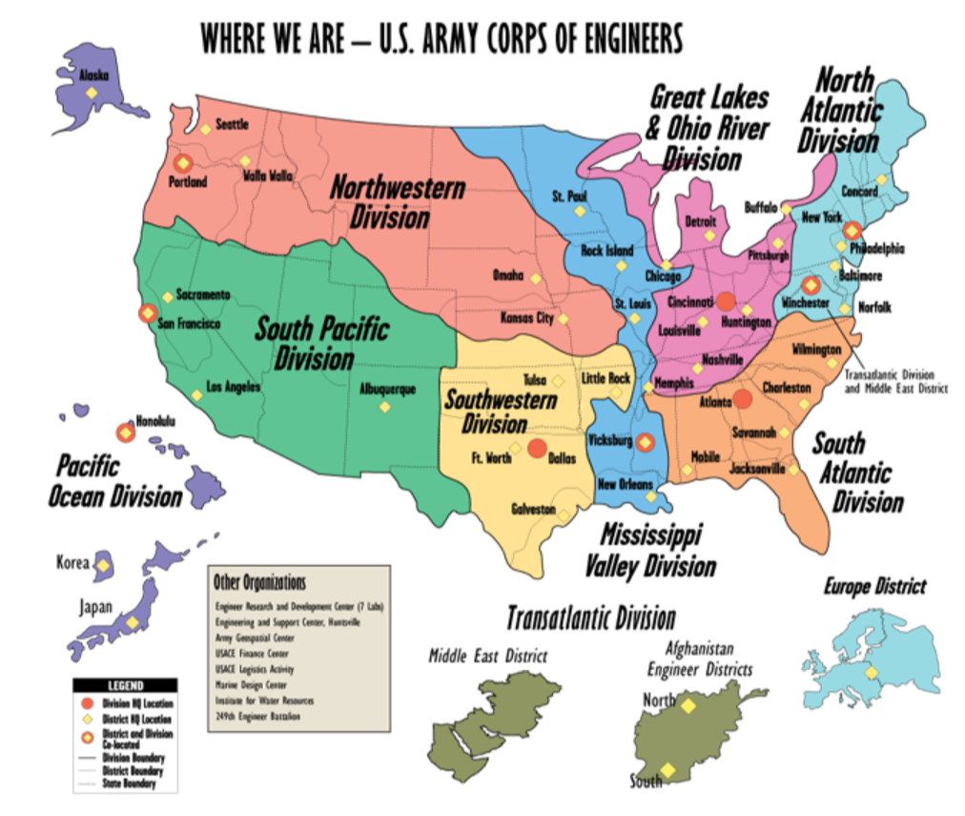
About UsACE
Mission: To deliver engineering and water resource solutions in collaboration with partners to:
Secure the Nation
Reduce disaster risk
Enhance quality of life
Provide value to the region
Areas of Interest:
Navigation
Flood Risk Management
Regulatory
Environmental Management/Restoration
Emergency Management
Recreation
Water Supply
Hydropower
More information about USACE-Rock Island

Slide 4
GIS in Project Management
USACE PM GIS - project-based section to provide:
Support, services, and solutions
(i.e. spatial data development, processing, analysis, visualization, and management)
Education, training, and outreach to other employees in the district
Some GIS application examples will be highlighted that support the USACE area of interests:
Flood Risk Management
Regulatory
Environmental Management/Restoration
Recreation
Water Supply

Slide 5
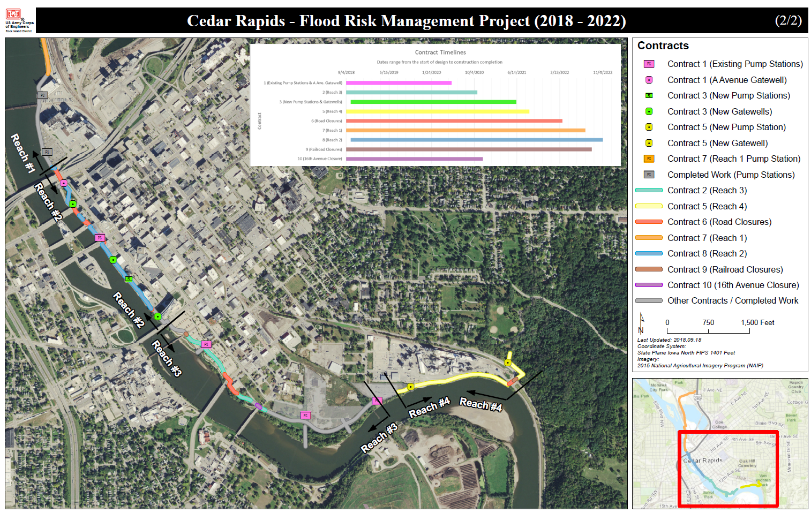
Flood Risk Management
Reduce overall flood risk (i.e., risk of loss of life, economic and environmental damages)
Risk analysis
Structural actions (i.e., levee & dams - design, construction, modification, and maintenance)
Non-structural actions (elevate or relocate structures)
Ex. Cedar Rapids FRM 2018-2022
Design & construction of levee, floodwalls, closures, and utilities
GIS
Data management & updates
Feature delineation & visualization
Dashboard development or project management tracking
10 contracts with 10-25 due dates each
Sections that are complete vs. in progress

Slide 6
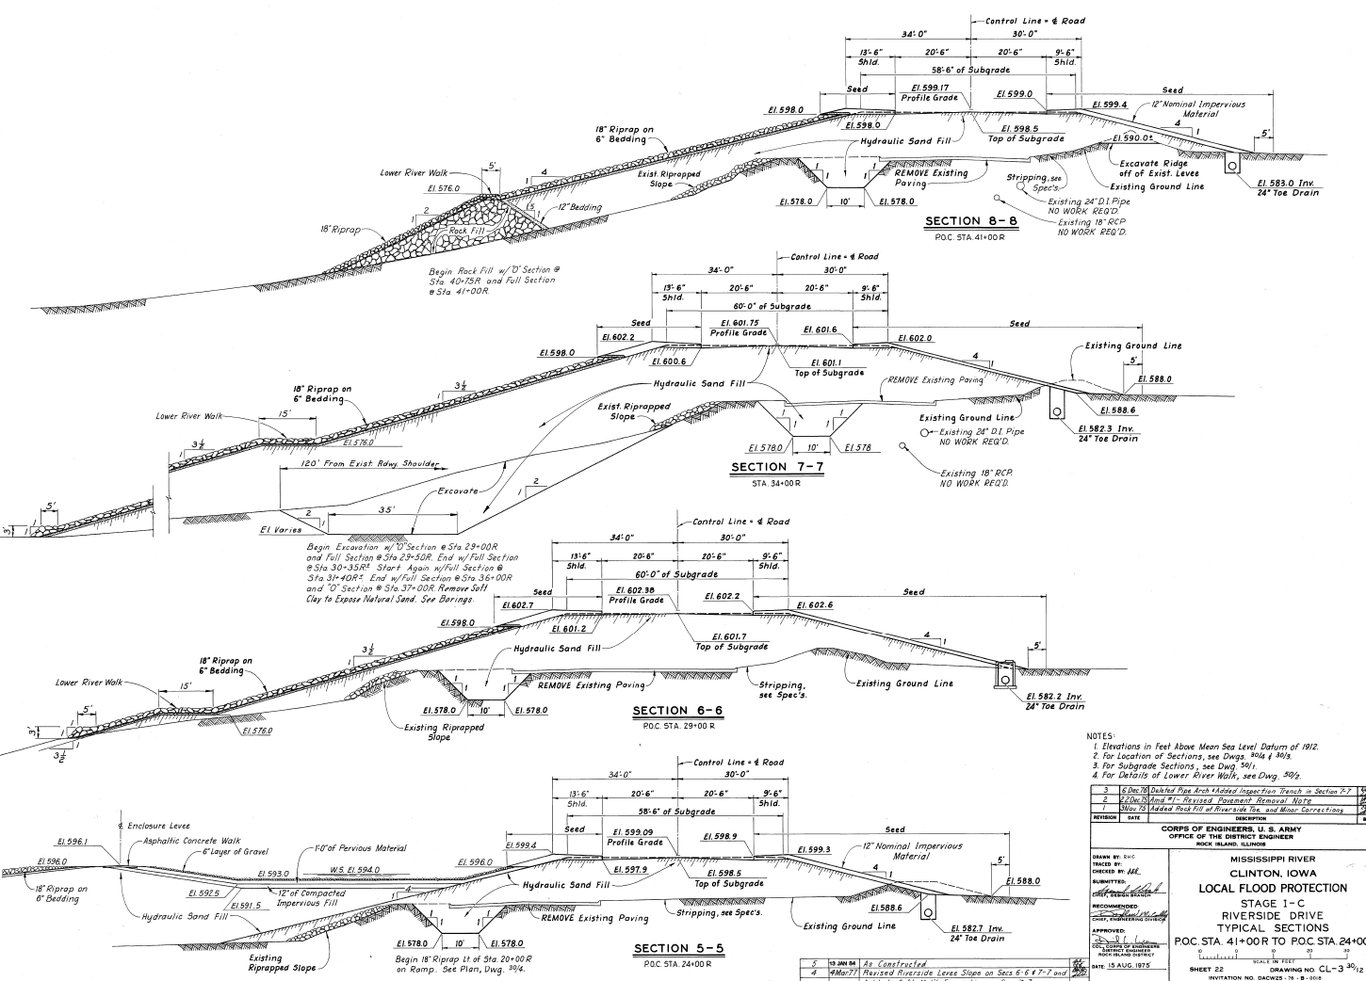
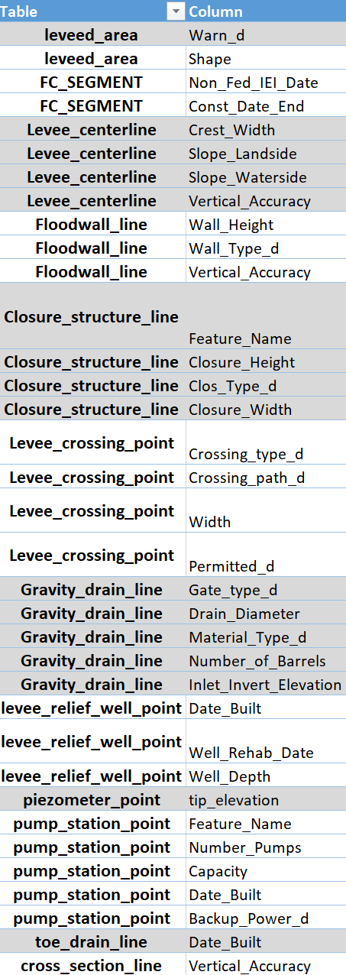
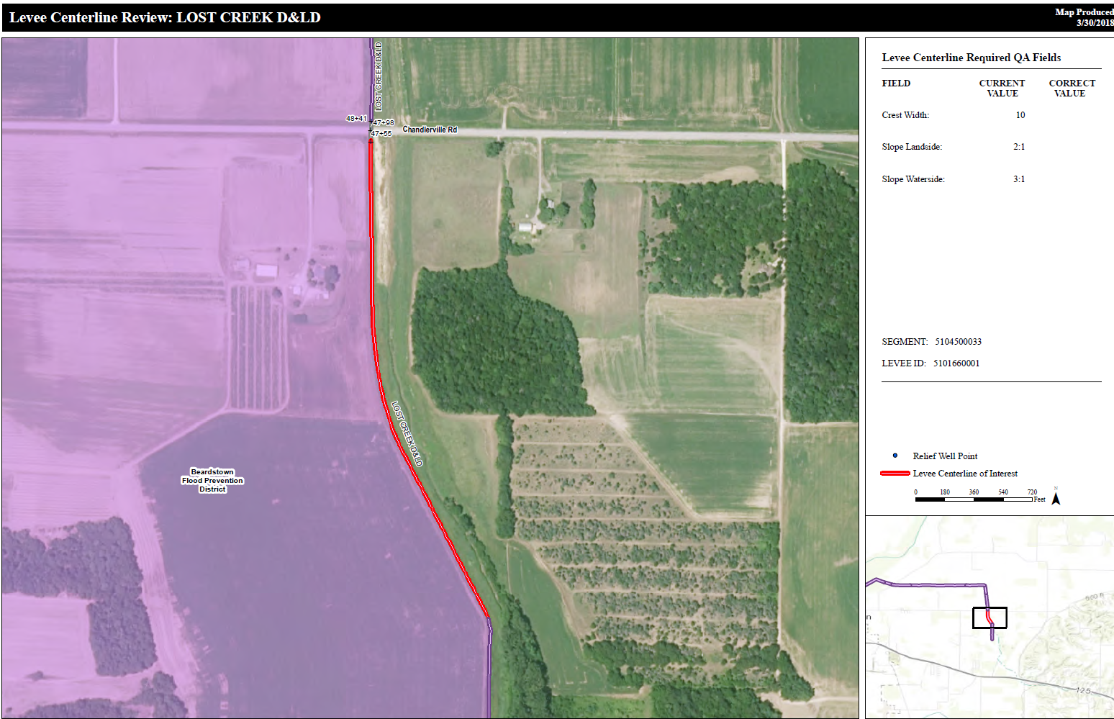
Flood Risk management
National Levee Database
Each district throughout USACE is responsible for QA/QC of levee systems in their region
GIS
Compare current NLD data to the original as-builts and update geometry in GIS as needed
Finished QA/QC data is sent to Kansas City district for uploading into the NLD online
Attribute data can now be updated online (with permissions)
Ability to make geometry updates online is under development

Slide 7
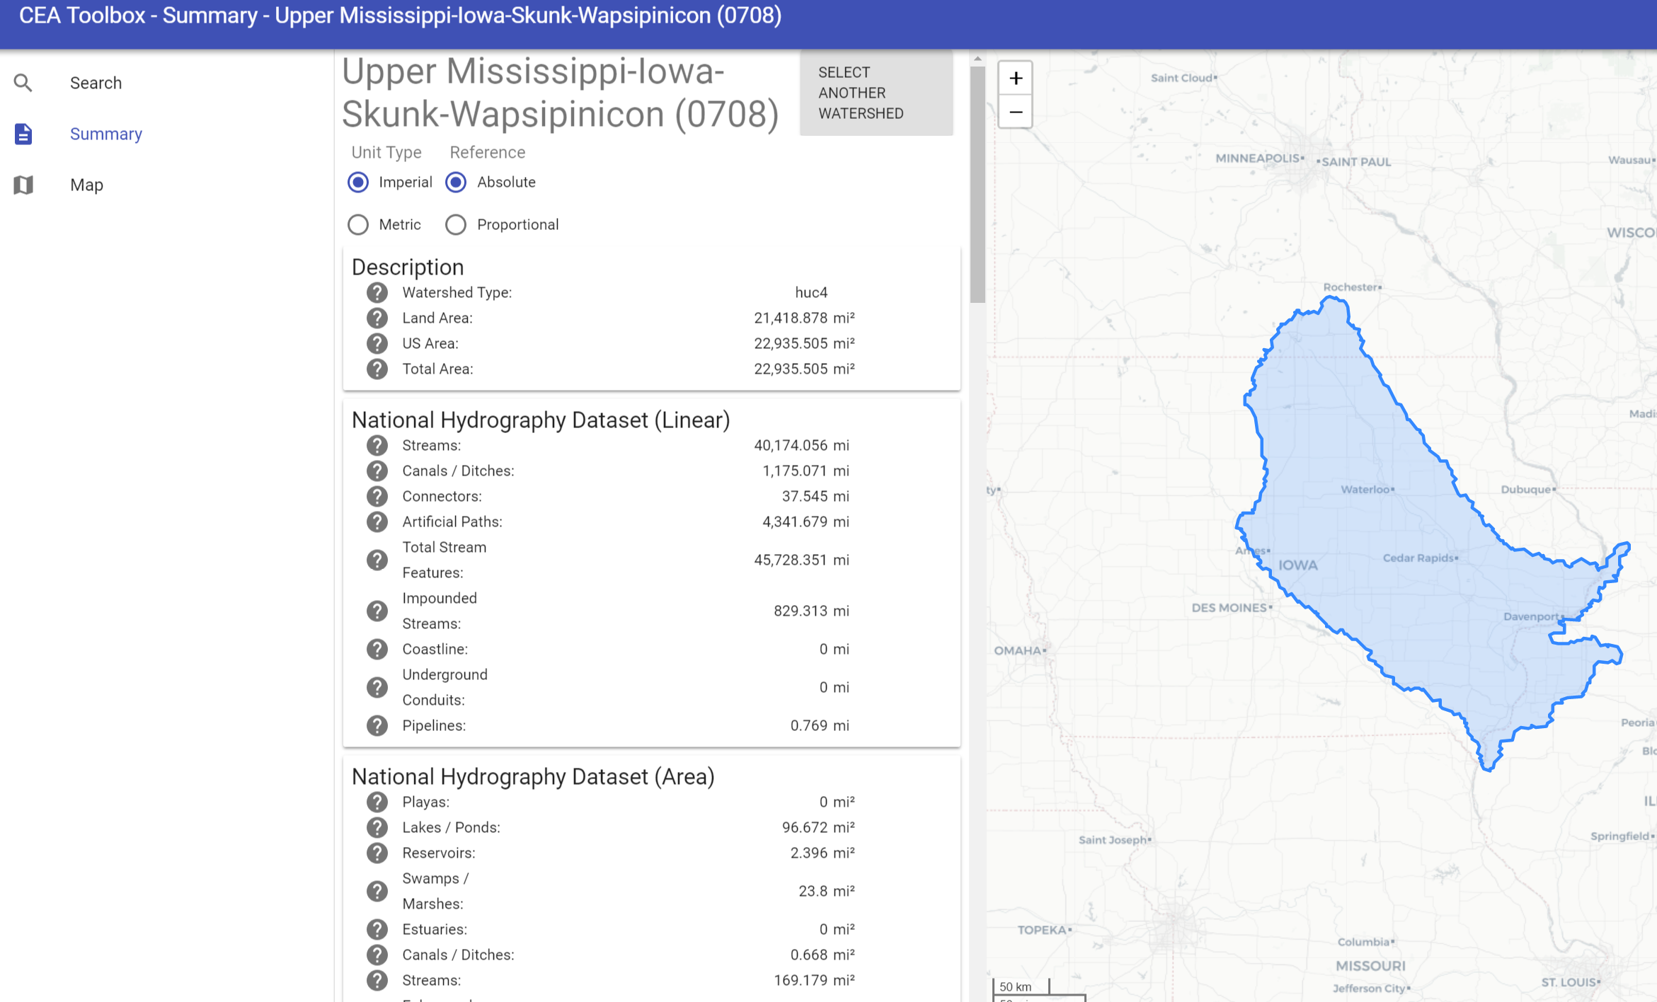
Regulatory
Cumulative Effects Analysis (CEA) tool:
Characterize watersheds & assess their condition
Provide streamline reporting to regulatory project managers
GIS
Modern Web Technologies (HTML5/CSS3/Javascript) with ReactJS framework and Leaflet map viewer
Data provided by REST web services via Oracle and Geoserver
Python scripting to summarize national & regional datasets
Machine learning to identify top watershed stressors
for regional analyses
Documentation in R

Slide 8
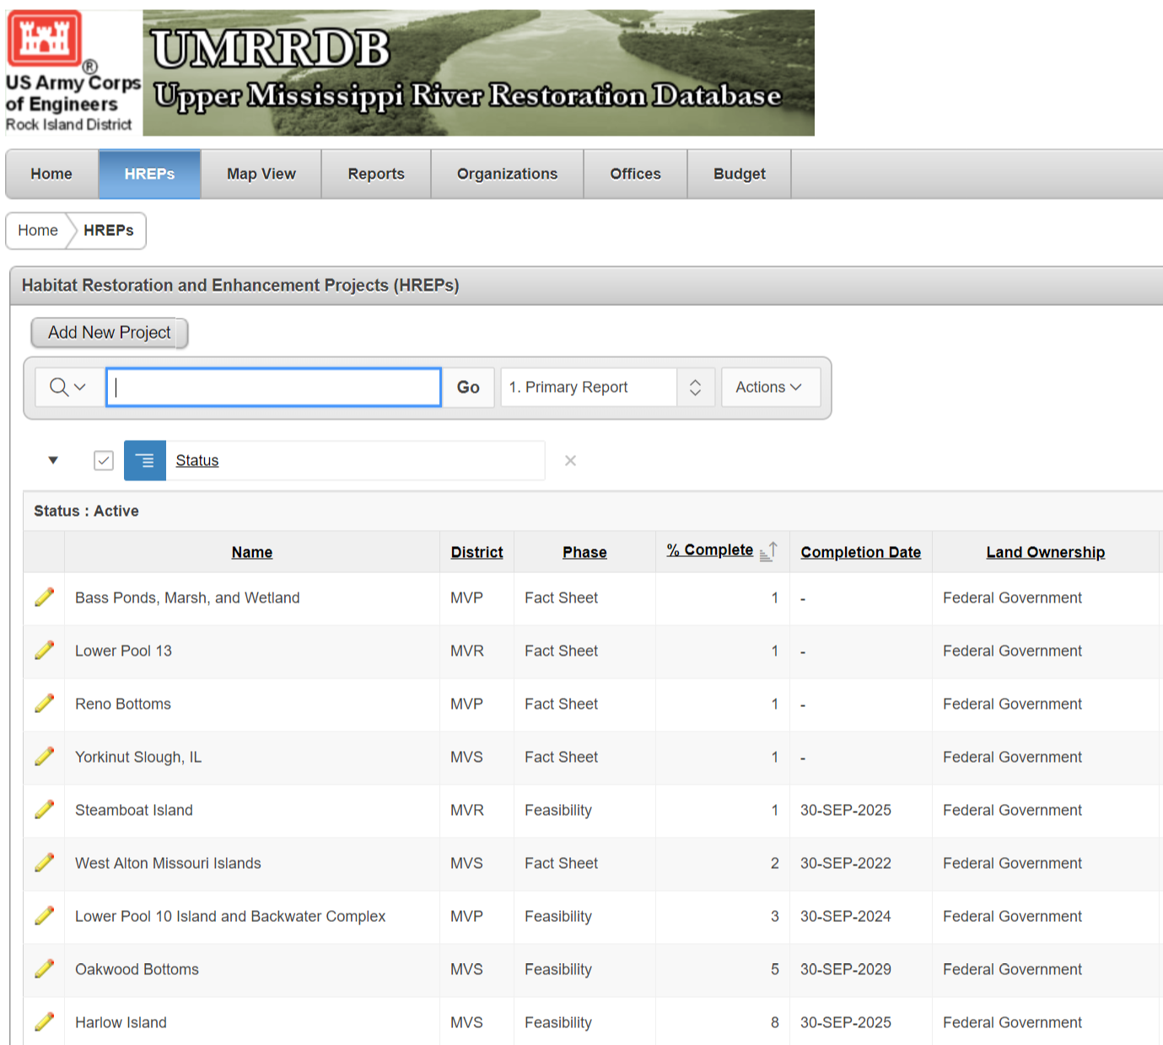
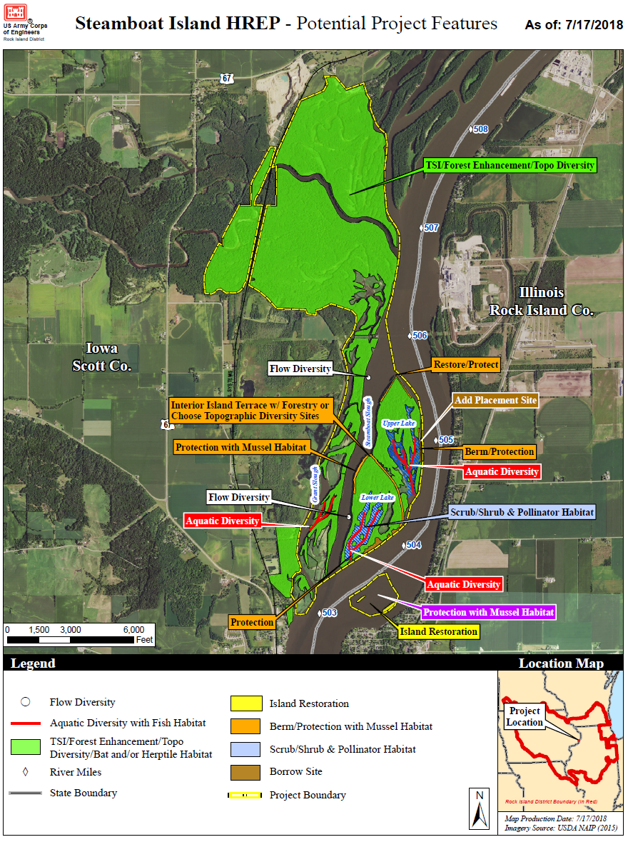
Environmental Management & Restoration
Upper Mississippi River Restoration (UMRR)
Environmental restoration & monitoring along the Upper Mississippi River System
Habitat restoration, monitoring, & research
GIS - UMRR-DB
Data provided through Oracle
Restoration features can be brought in to GIS for editing & updates
Employees can access or edit data (depending on permissions) for progress and budgeting reports through APEX (Oracle’s application express)

Slide 9
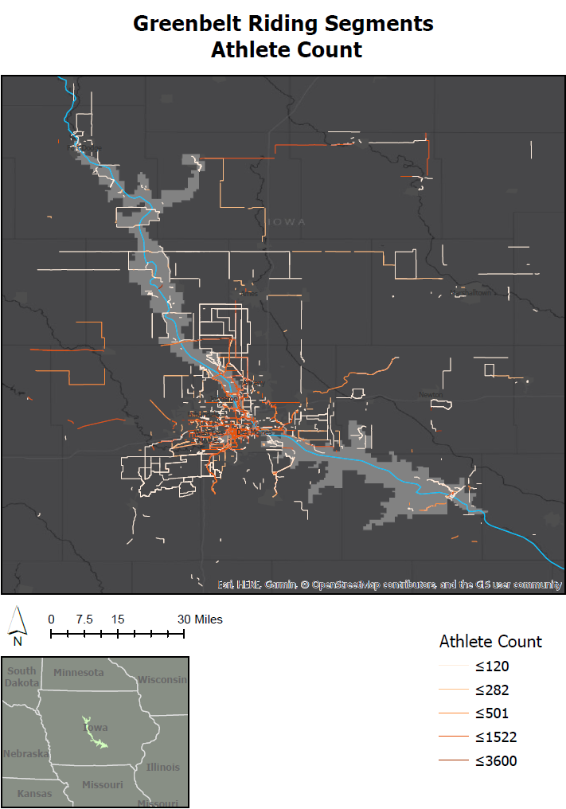
Recreation
Sample Response: {"segments":[
{
"id":669452
"resource_state":2
"name":"WDM Soccer Climb"
"climb_category":0
"climb_category_desc":"NC"
"avg_grade":4.2,
"start_latlng":[41.537517,-93.729398],
"end_latlng":[41.537465,-93.721686],
"elev_difference":29.3,"distance":692,
"points":"mxo|Fvoa{P?eCAaA@...
"starred":false
}
...
Greenbelt Area (Des Moines, IA)
Project managers wanted to get an idea of recreation activity in the area
Data from the Strava API was requested (athlete and effort count)
GIS
Develop bounding boxes/algorithm to search study area in sections (limited to receiving 10 segments per request for each bounding box)
Python
Access the Strava API and make multiple requests, one for each bounding box – limited to 30,000 requests/day
Convert Google polyline format to geojson
Convert geojson to shapefile format
Data visualization

Slide 10
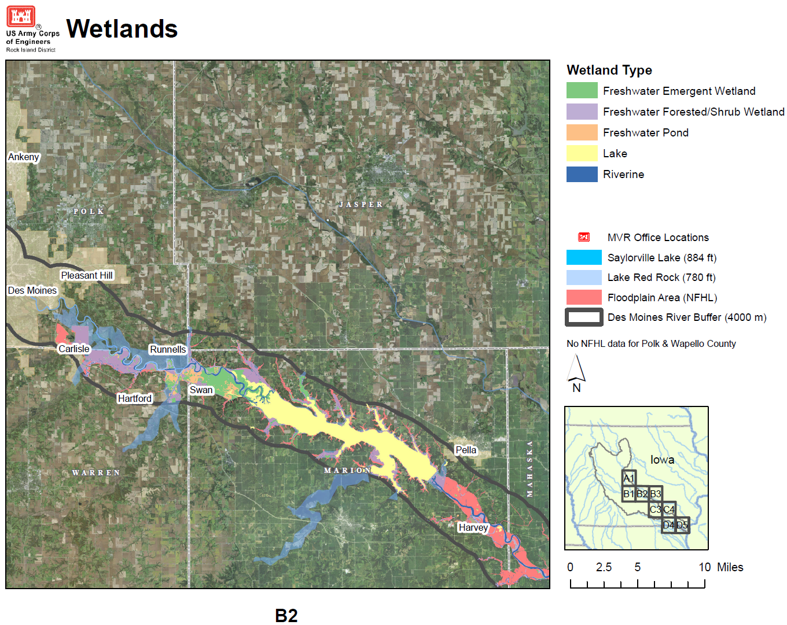
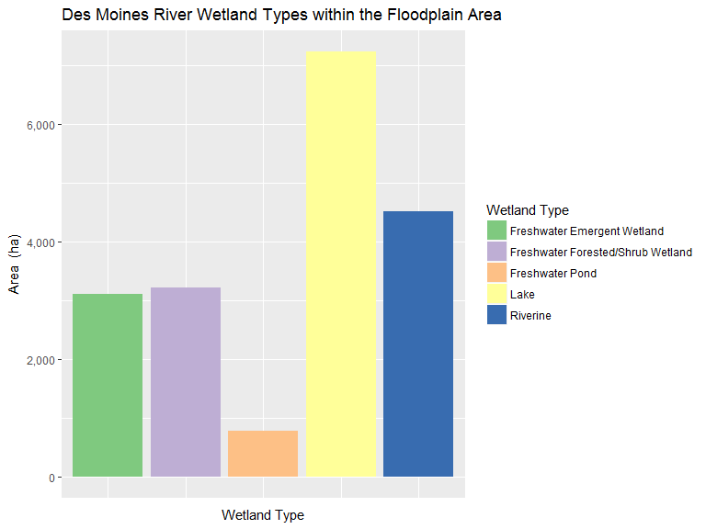
Water supply
Des Moines River Water Control Study
Study done for adjusting output flows of the Saylorville Lake and Red Rock dams
GIS
Research format, and visualize datasets that present current conditions to identify risk or opportunities
Graphing and documentation in R to present in a final report

Slide 11
conclusion
GIS at USACE presents the opportunity to be involved in many different projects and utilizes a broad scope of GIS knowledge, resources, tools, and applications, including:
Data development, processing, analysis, visualization and management
Programming
Queries
Documentation
Scripting
Web Application Development

Slide 12
Thank you
Contact
Mary Windsor
Geographer, Project Management
US Army Corps of Engineers-Rock Island District
Clock Tower Building
1500 Rock Island Drive
Rock Island, IL 61204
Mary.B.Windsor@usace.army.mil
Pathways Internship Position Details:
https://www.usajobs.gov/GetJob/ViewDetails/510455300

